Slide 1
K8UY 2m Yagi Uda Analysis
Antenna propagation modelling
Comparing Vertical to Horizontal Polarization
Comparing Free Space to Real Ground
Comparing 4.5m height to 9.5m height
Performed by KQ4TIV
2026.05.03 – Rev n

Slide 2
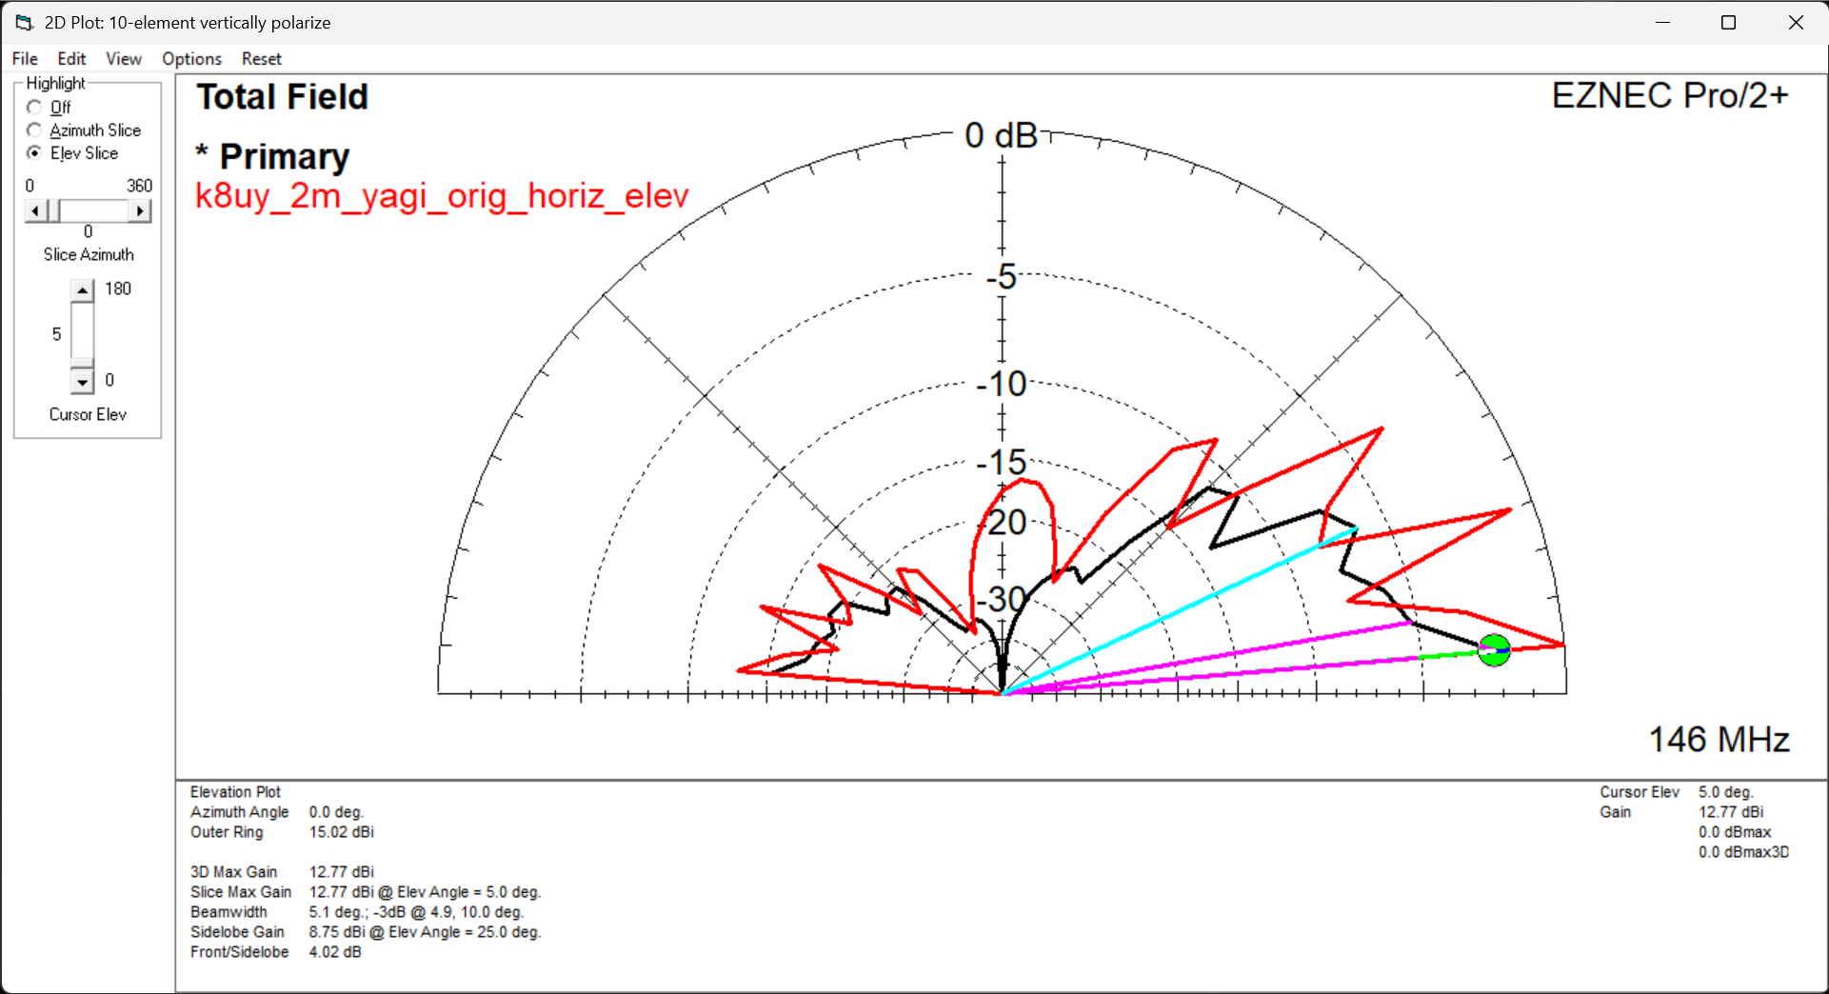
Elevation Comparison – Vert/Horiz
Black = Vert
Red = Horiz
Original Design
Assumptions:
Real ground
146MHz
Copper pipe ½”
No matching or transformers

Slide 3
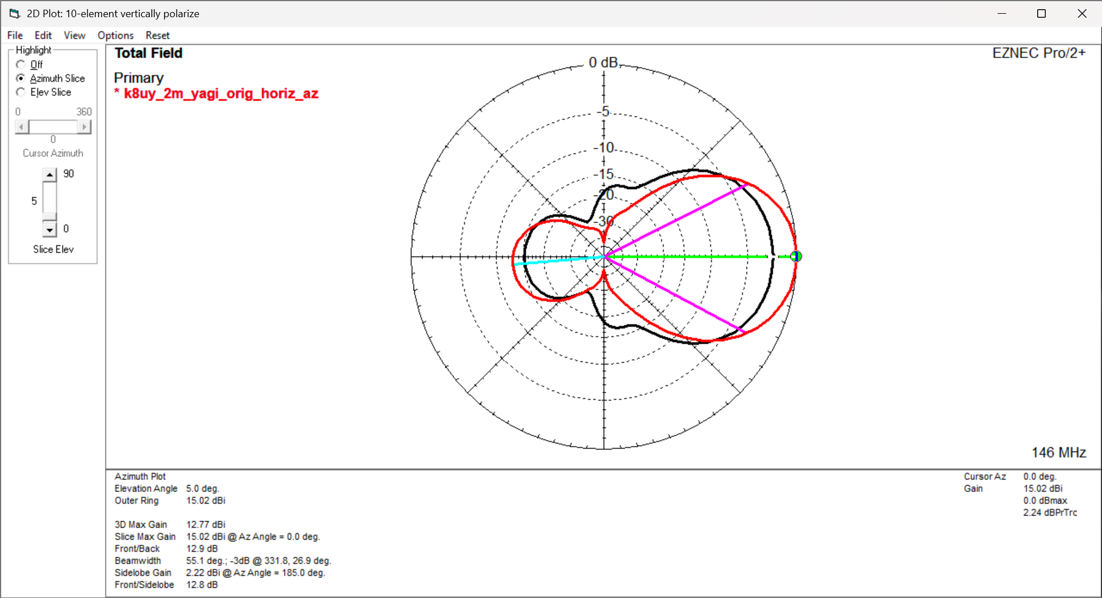
Azimuth Comparison – Vert/Horiz
Black = Vert
Red = Horiz
Original Design
Assumptions:
Real ground
146MHz
Copper pipe ½”
No matching or transformers

Slide 4
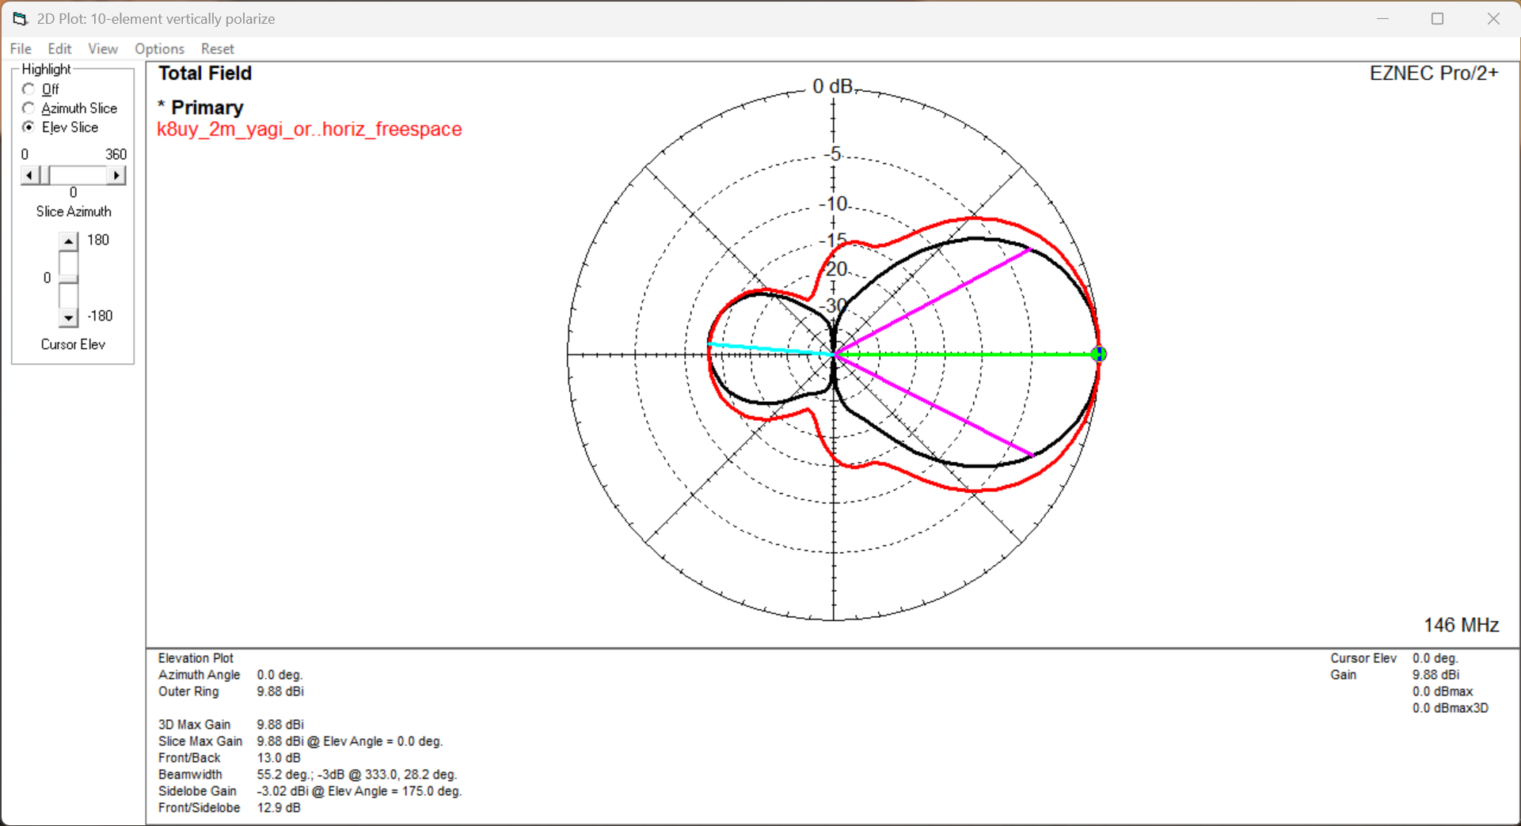
Freespace Elevation Comparison – V/H
Black = Vert
Red = Horiz
Original Design
Assumptions:
Freespace
146MHz
Copper pipe ½”
No matching or transformers

Slide 5
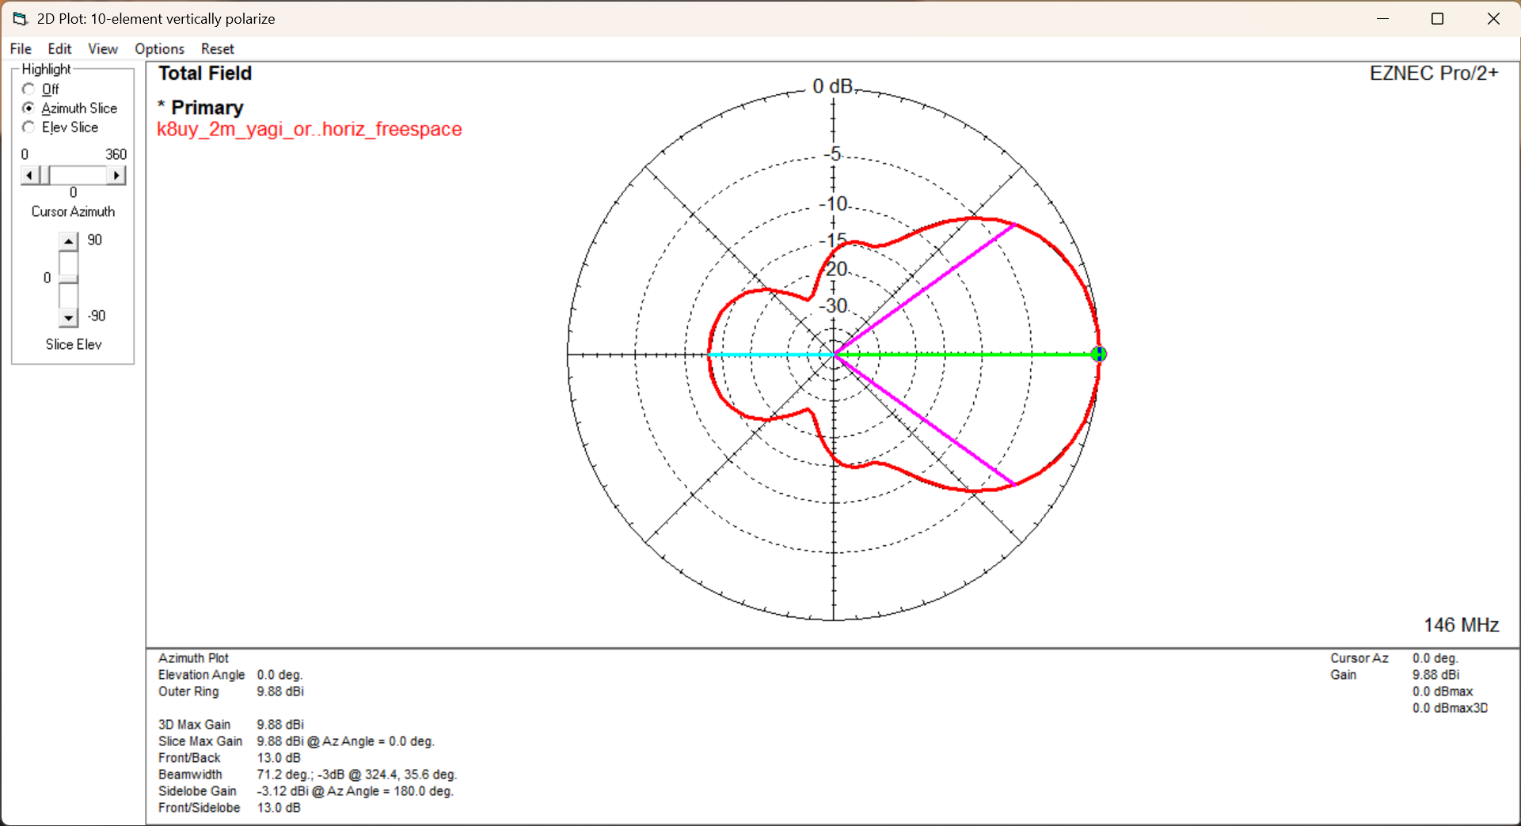
Freespace Azimuth Comparison – V/H
In freespace vertical and horizontal polarization have same azimuth propagation
Black = Vert
Red = Horiz
Original Design
Assumptions:
Freespace
146MHz
Copper pipe ½”
No matching or transformers

Slide 6
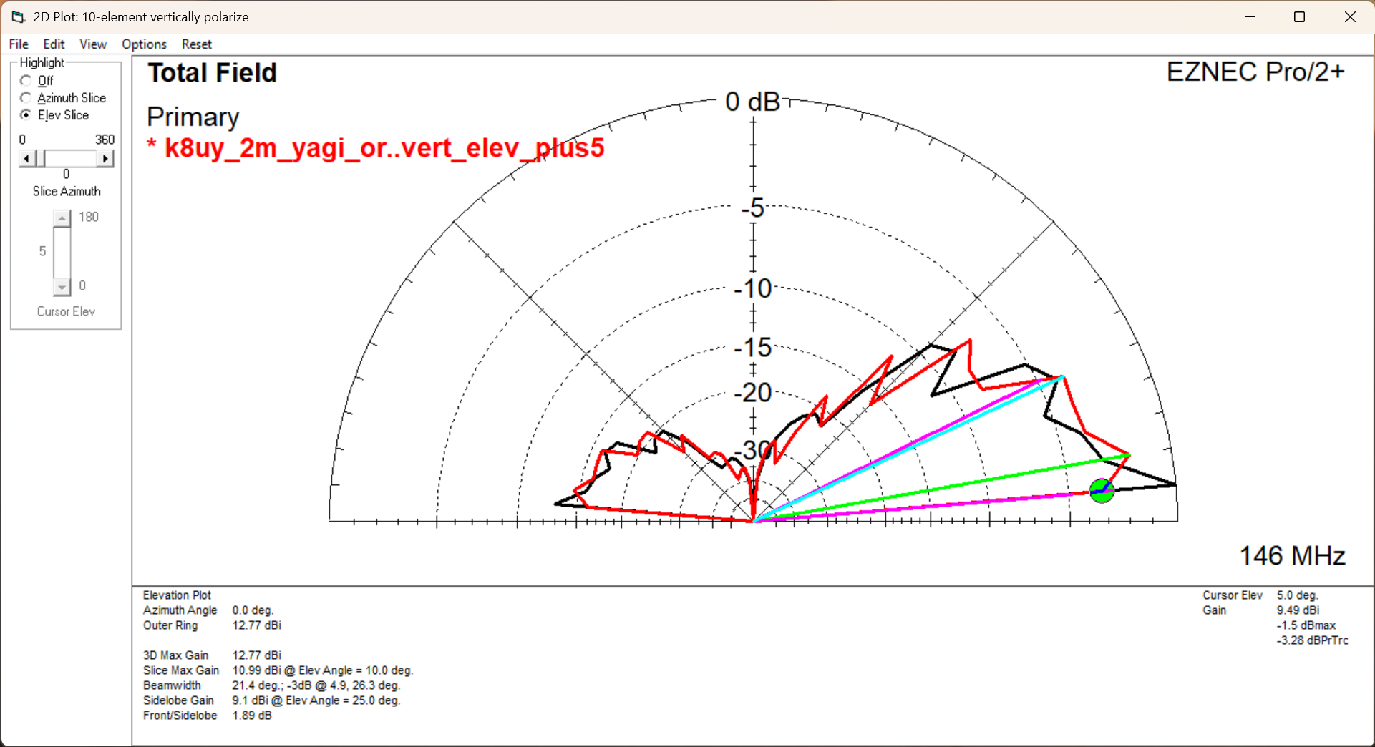
Elevation Comparison – Vertical – Orig/+5m
Black = Vert
Red = Horiz
Original Design
Assumptions:
Real ground
146MHz
Copper pipe ½”
No matching or transformers

Slide 7
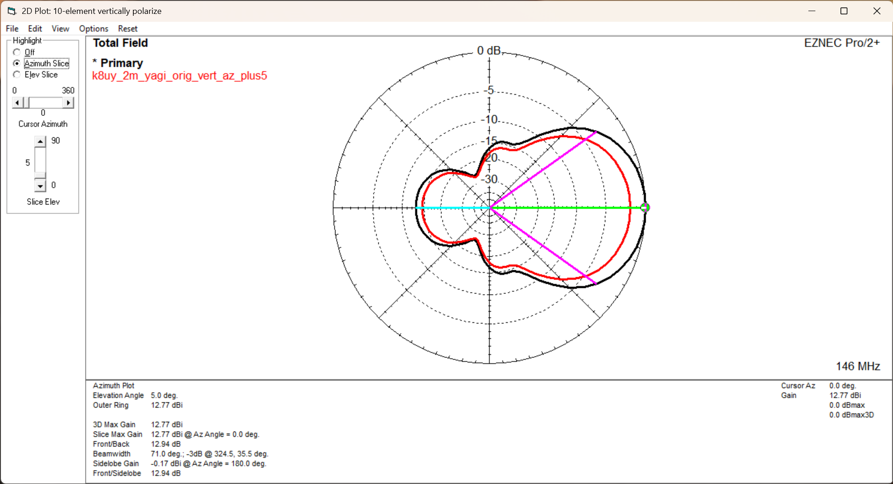
Azimuth Comparison – Vertical – Orig/+5m
Black = Vert
Red = Horiz
Original Design
Assumptions:
Real ground
146MHz
Copper pipe ½”
No matching or transformers

Slide 8
Improvement
TBD

